Slide 1
Status Report
Wooyeon Kwon
wkwon@cern.ch
10 Feb, 2025

Slide 2
Plans
Goal
Make ‘RPC tuned global muon ID’ which is including RPC information(isGlobal muon & isRPC muon).
And evaluate the RPC tuned global muon ID
Steps
Through Z->mumu mass reconstruction with tight id muon, tune pt of muons
Test if ‘RPC tuned global muon ID’ works well, in Z->mumu reconstruction
With MC, define RPC, Global and RPC tuned global muon. And compare their efficiency.
With Data and MC, using TnP compare muon objects above. And compare their efficiency
Finally calculate scale factor of ‘RPC tuned global muon’ with MC and Data

Slide 3
Dataset and MC
Run3 data at $\sqrt{s}=13.6 TeV$ and MC sample.
*Lumimask : Cert_Collisions2022_355100_362760_Golden.json
*HLT Trigger : HLT_IsoMu24_v
DATA(2022) | LHC Delivered ($fb^{−1}$) | Recorded by CMS($fb^{−1}$) | Golden JSON($fb^{−1}$)
/Muon/Run2022C-27Jun2023-v1/AOD | 7.0067 | 6.3777 | 5.0104
/Muon/Run2022D-27Jun2023-v2/AOD | 3.8044 | 3.3773 | 2.9700
total | 10.8111 | 9.7550 | 7.9804
Drell Yan MC sample (# 2924957 events)
/DYto2Mu_MLL-50to120_TuneCP5_13p6TeV_powheg-pythia8/Run3Summer22DRPremix-124X_mcRun3_2022_realistic_v12-v2/AODSIM

Slide 4
Selections
Muon Definition
$p_{T}>24GeV +\left|η\right|<2.4+$Tight ID + Tight PF Isolation ( $Iso_{PF}^{Rel}<0.15$ )
* Isolation definition : $Iso_{PF}^{Rel}=[ \sum_{\begin{aligned}charged \\ hadron\end{aligned}}{p_{T}}+\max{(0, \sum_{\begin{aligned}neutral \\ hadron\end{aligned}}{E_{T}}+\sum_{photon}{E_{T}} −} 0.5 ∗\sum_{pileup}{p_{T}})] /p_{T}^{μ}$
Event selection
S1. Events with number of muons ≥ 2
Object Selection
Select a muon pair with condition below per one event
S1. z distance of a muon pair$\left|dz_{μμ} \right|<0.5$
S2. Opposite electric charge of a muon pair
S3. Z mass is reconstructed with a muon pair whose invariant mass is closest to 91.1876GeV.

Slide 5
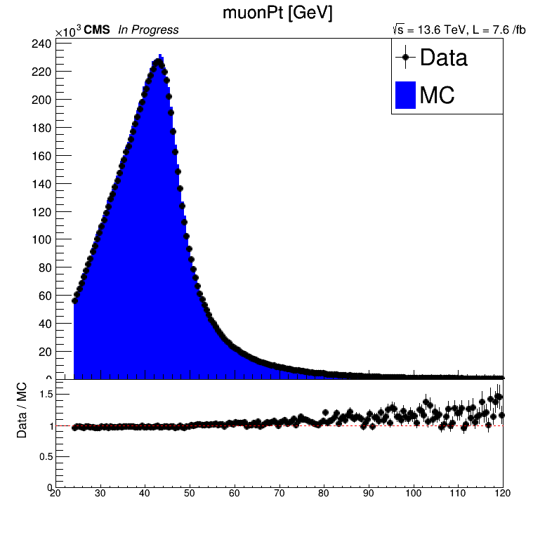
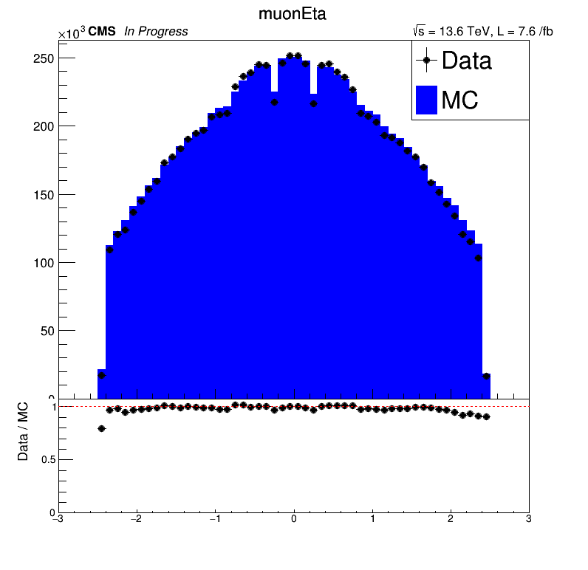
Distribution of muons

Slide 6
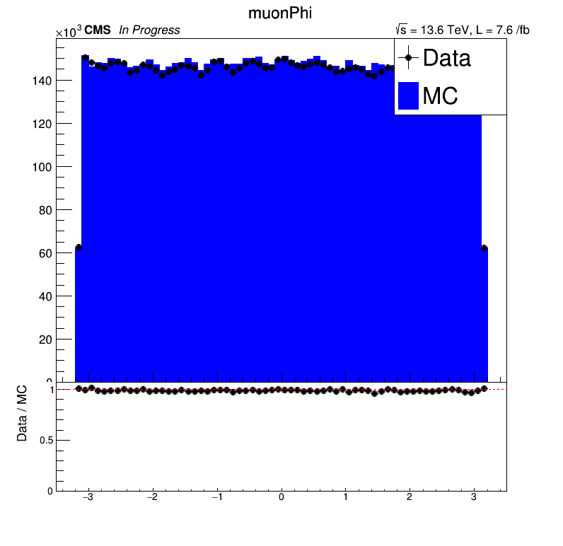
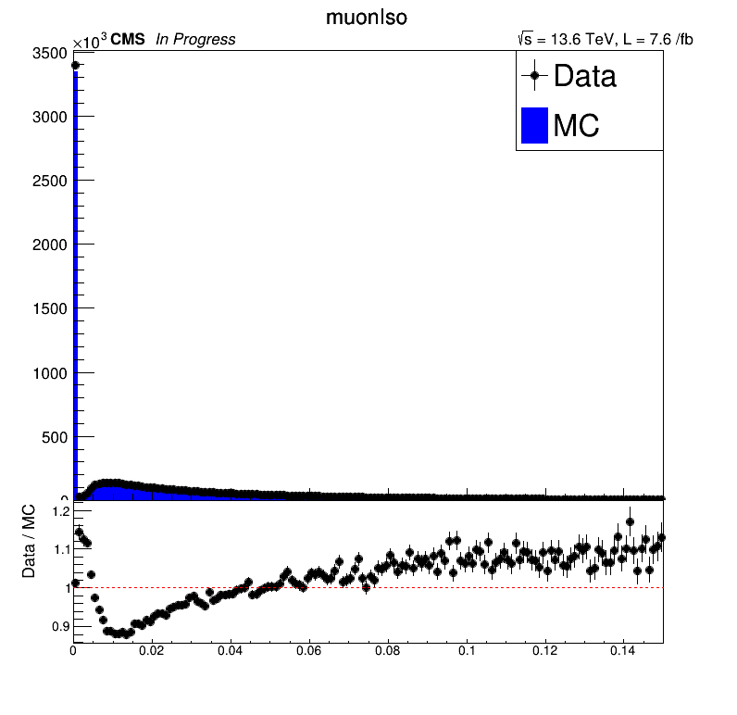
Distribution of muons

Slide 7
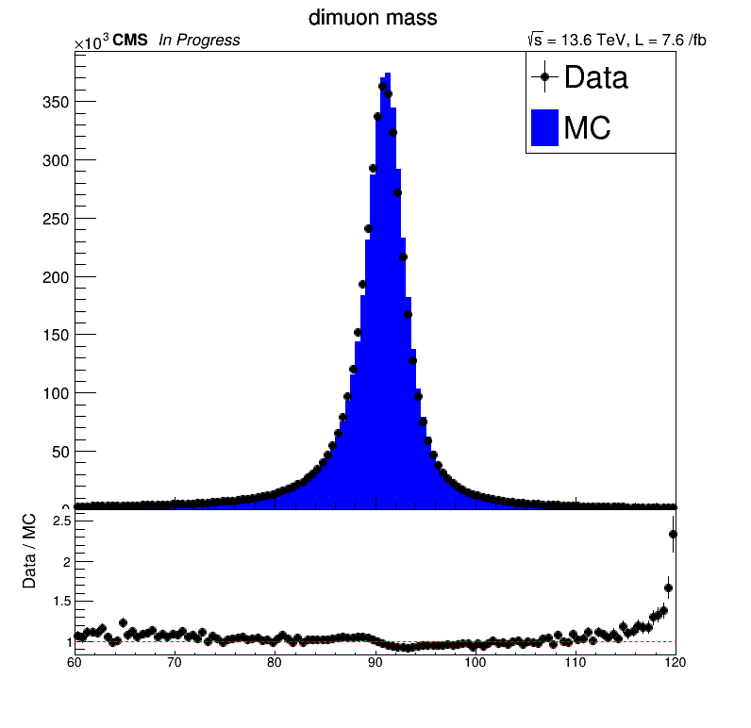
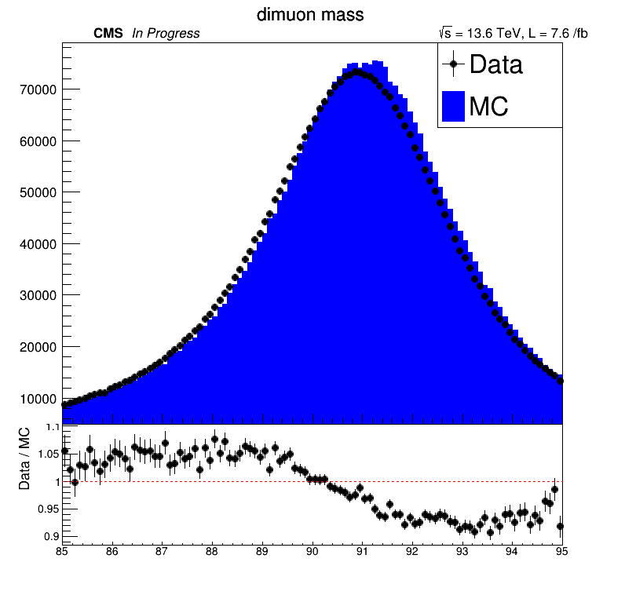
dimuon mass distribution

Slide 8
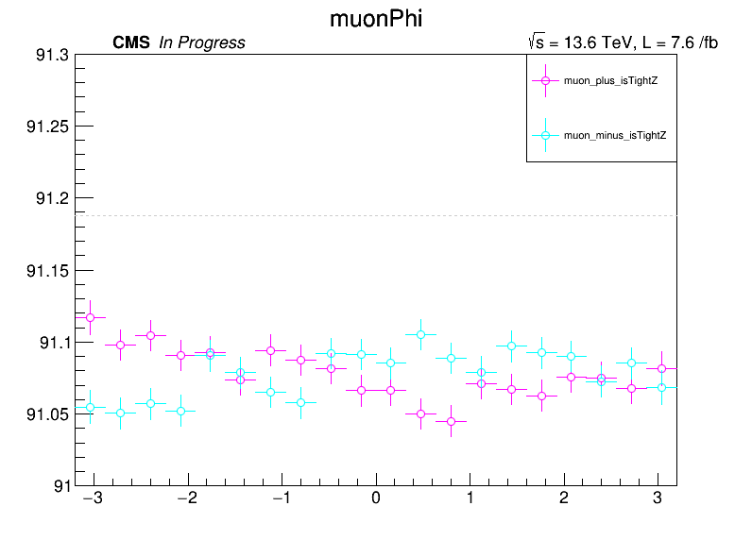
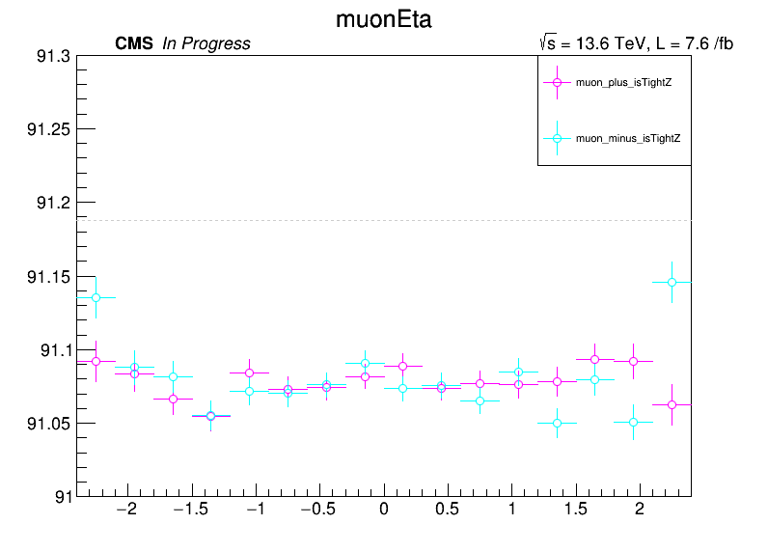
Average invariant mass per bin
Average invariant mass per bin. grey dot line is pdg Z mass(91.1876GeV)
There is misalignment and it has dependency for charge, eta and phi
So, it should be corrected

Slide 9
Selections with RPC Muon
Muon Definition
RPCMuon + $p_{T}>24GeV +\left|η\right|<2.4+$Tight ID + Tight PF Isolation ( $Iso_{PF}^{Rel}<0.15$ )
* Isolation definition : $Iso_{PF}^{Rel}=[ \sum_{\begin{aligned}charged \\ hadron\end{aligned}}{p_{T}}+\max{(0, \sum_{\begin{aligned}neutral \\ hadron\end{aligned}}{E_{T}}+\sum_{photon}{E_{T}} −} 0.5 ∗\sum_{pileup}{p_{T}})] /p_{T}^{μ}$
Event selection
S1. Events with number of muons ≥ 2
Object Selection
Select a muon pair with condition below per one event
S1. z distance of a muon pair$\left|dz_{μμ} \right|<0.5$
S2. Opposite electric charge of a muon pair
S3. Z mass is reconstructed with a muon pair whose invariant mass is closest to 91.1876GeV.

Slide 10
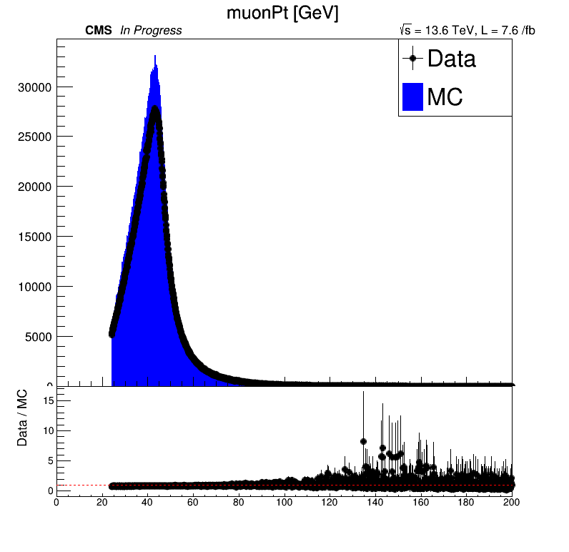
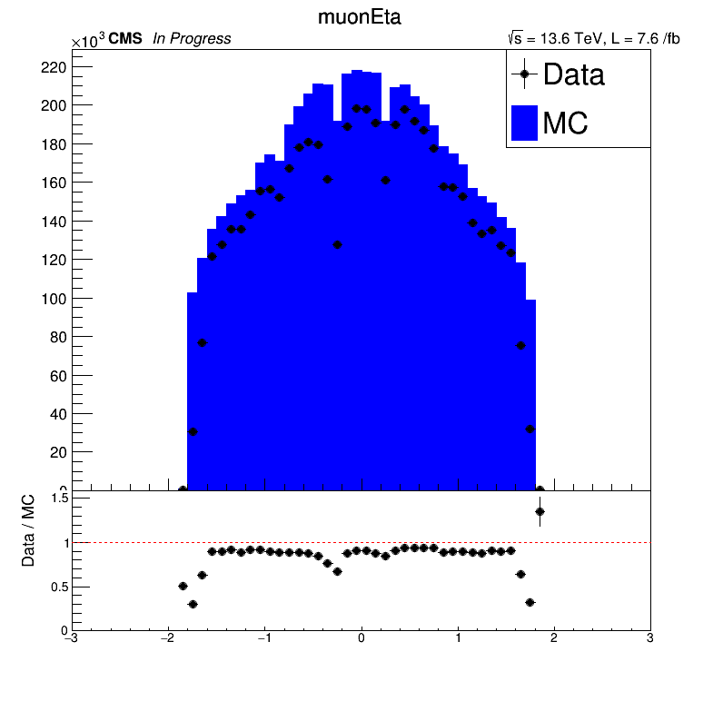
Distribution of muons– RPC Muon

Slide 11
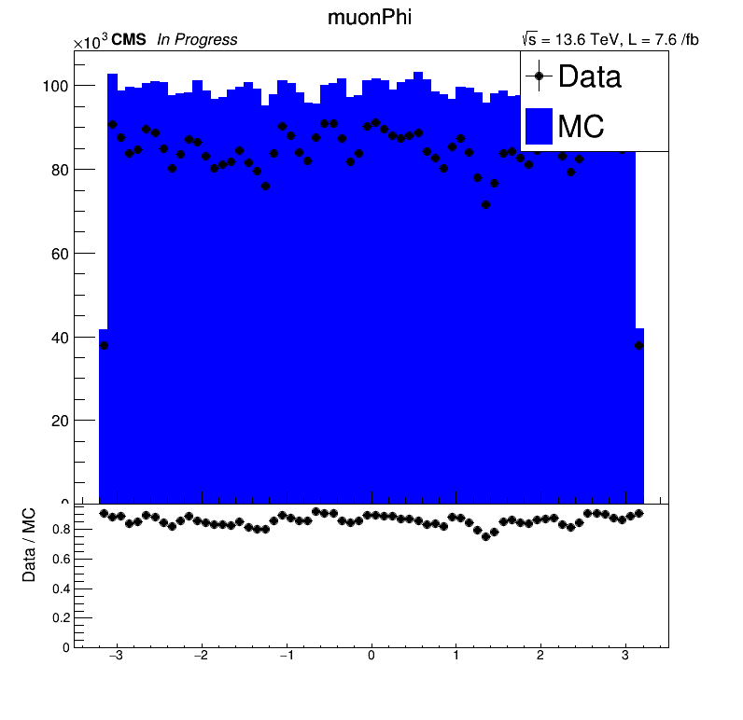
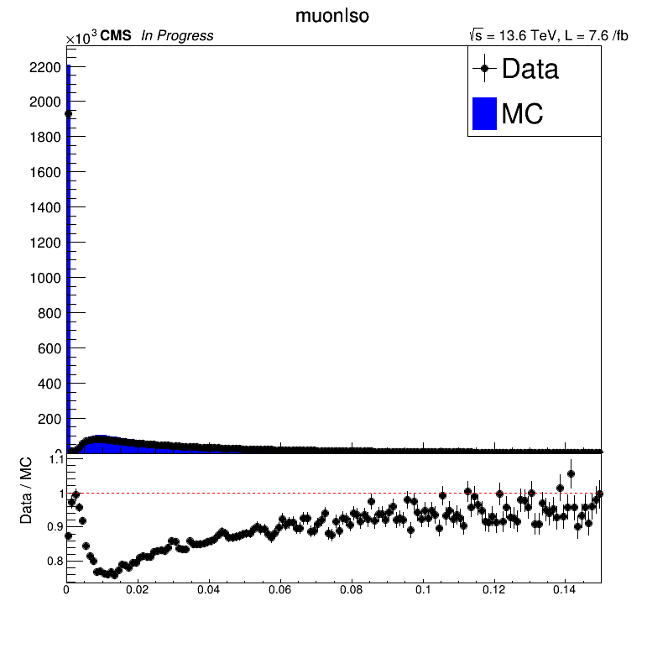
Distribution of muons– RPC Muon

Slide 12
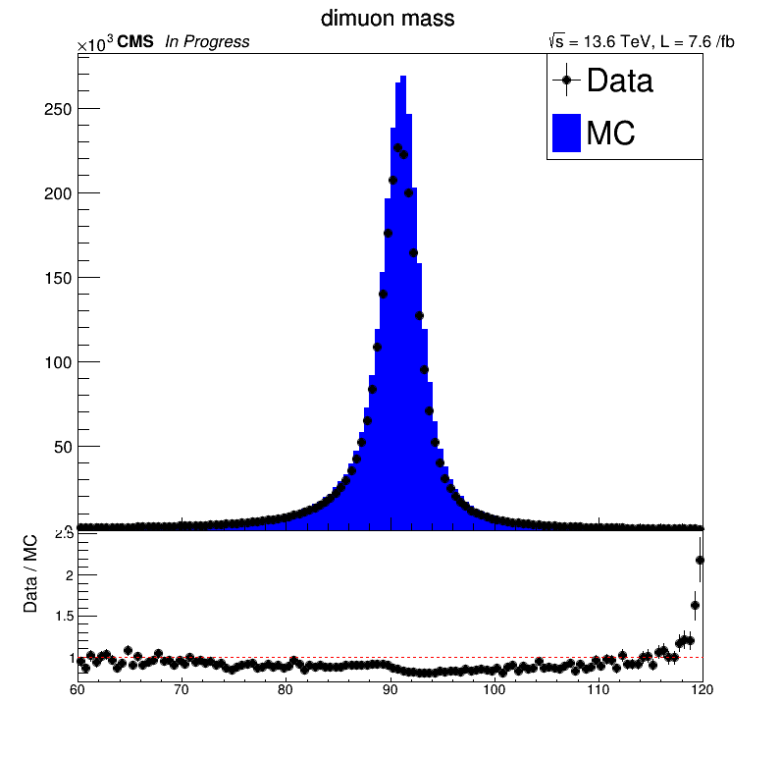
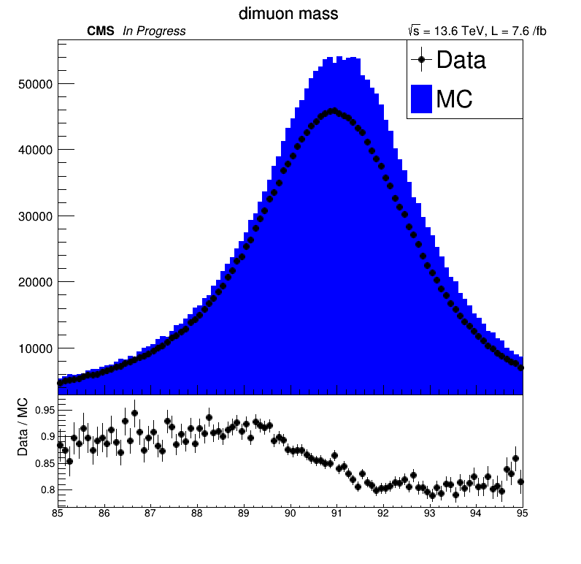
dimuon mass distribution– RPC Muon

Slide 13
MC Matching
MC Truth Matching for muon
pdgID = 13
check charge matching
ΔR threshold < 0.3
Relative pT difference < 0.5
one to one match by ΔR
Matching Efficiency Definition
$Matching Efficiency= \frac{\text{\# (}\text{Matched}\text{ \&\& }\text{muon} \text{ID} \text{condition}\text{)}}{\text{\#}\text{GenMuon}}$
Fake Rate Definition
$Matching Efficiency= \frac{\text{\# (}\text{!}\text{Matched}\text{ \&\& }\text{muon} \text{ID} \text{condition}\text{)}}{\text{\#}\text{GenMuon}}$

Slide 14
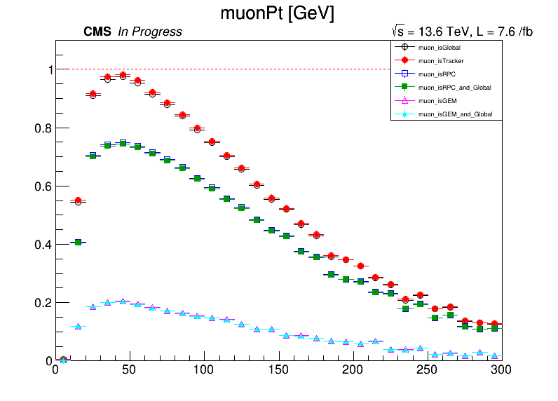
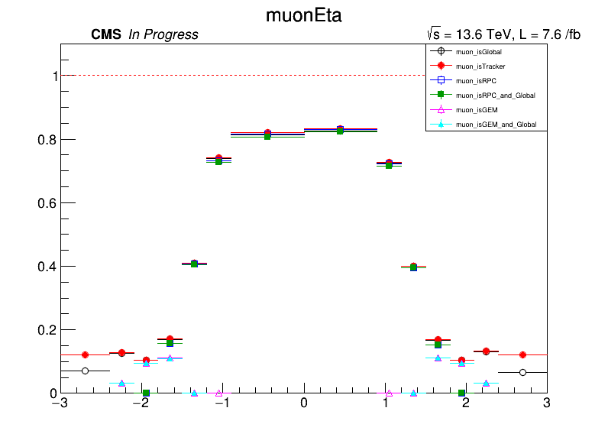
Matching efficiency

Slide 15
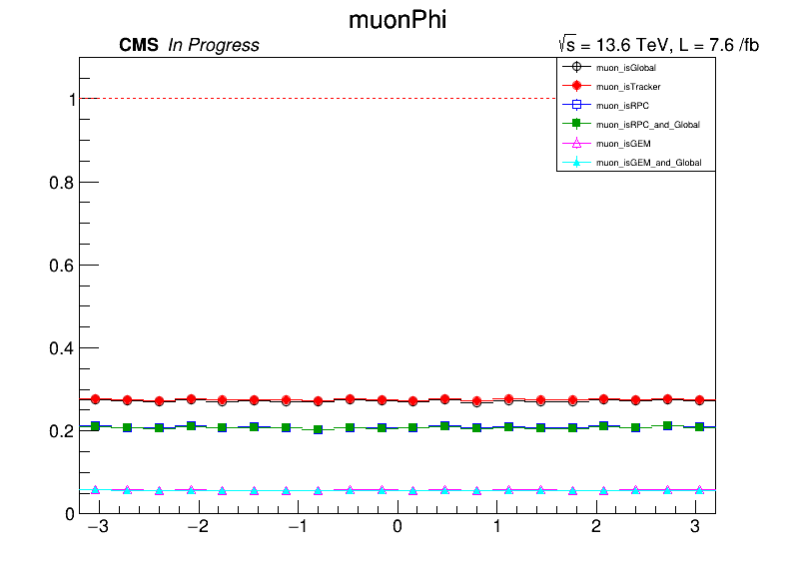
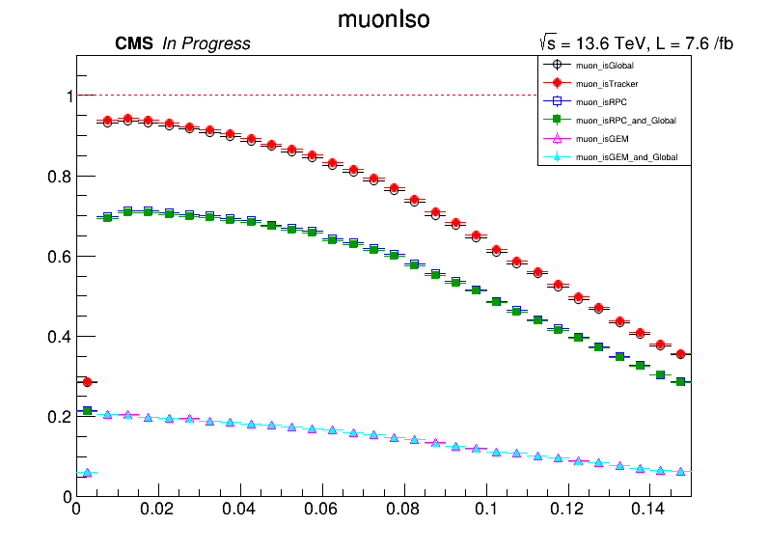
Matching efficiency

Slide 16
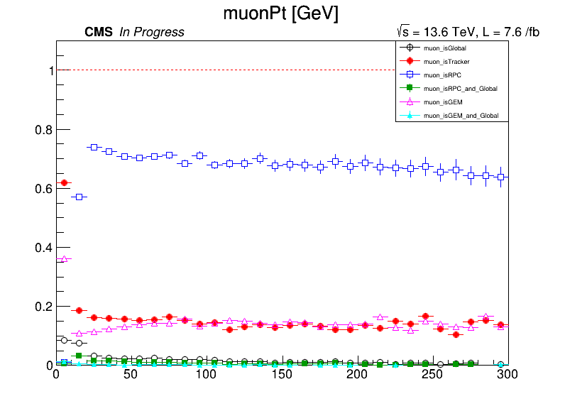
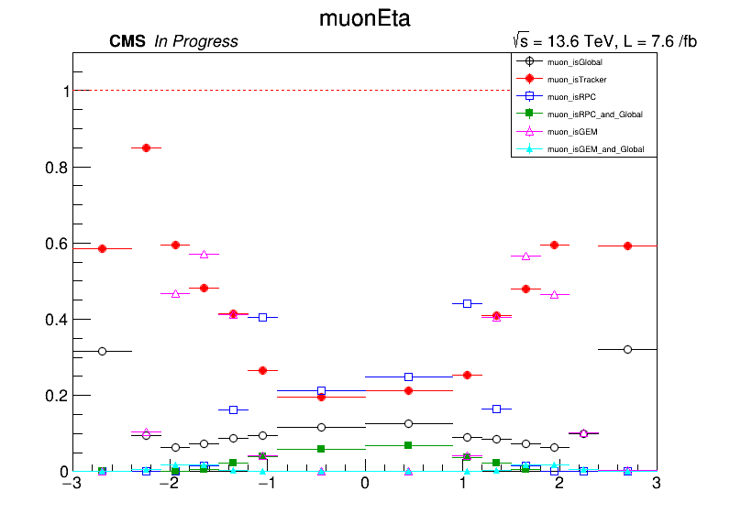
Fake rate

Slide 17
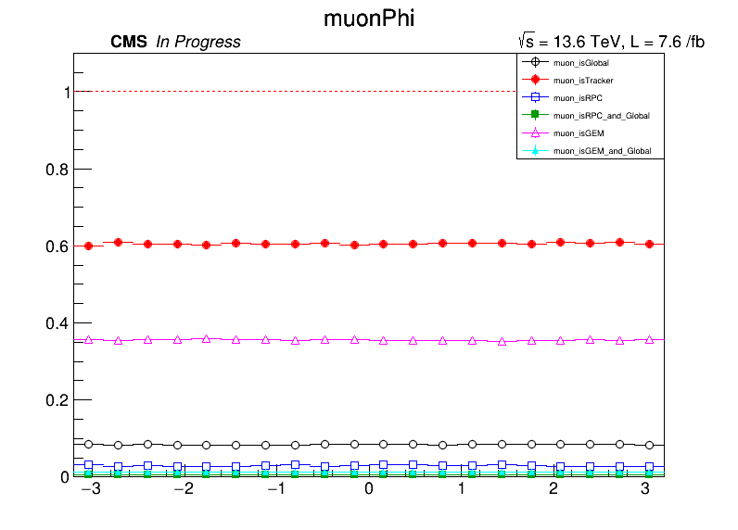
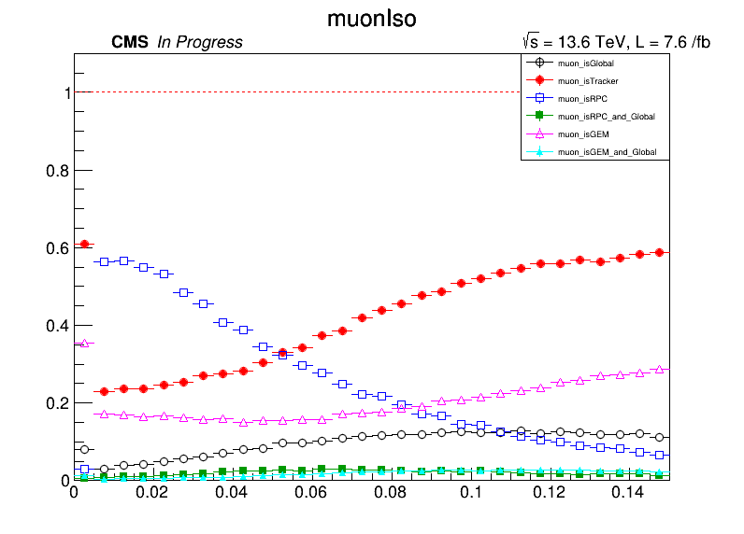
Fake rate

Slide 18
Tag and Probe
Tag Muon
$p_{T}>24GeV +\left|η\right|<2.4+$Tight ID + Tight PF Isolation ( $Iso_{PF}^{Rel}<0.15$ )
Probe Muon
Tracker Muon + $p_{T}>15GeV +\left|η\right|<2.4$ + opposite charge with the Tag muon
Event Selection
S1. mass window = [60,120]
S2. dvz < 0.5 (difference between vz of dimuon pair)
Passing Probe
GlobalMuon & RPCMuon
$efficiency= \frac{\#(passing probe)}{\#(all probe)}$

Slide 19
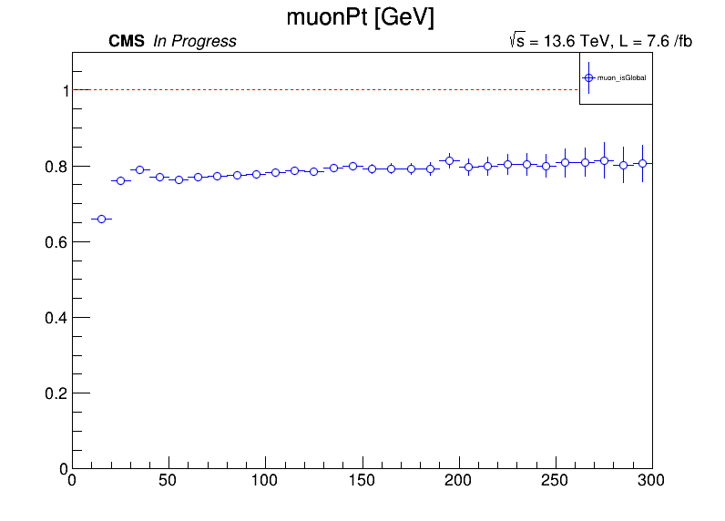
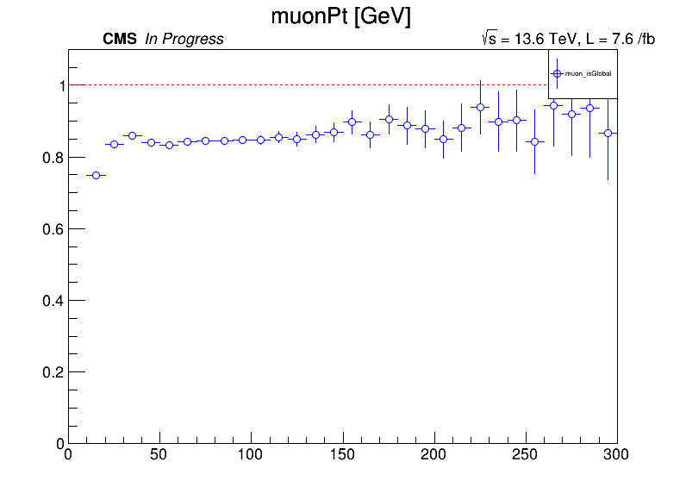
Efficiency Data vs MC

Slide 20
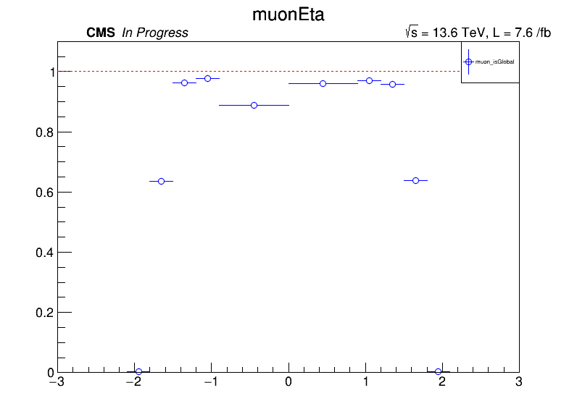
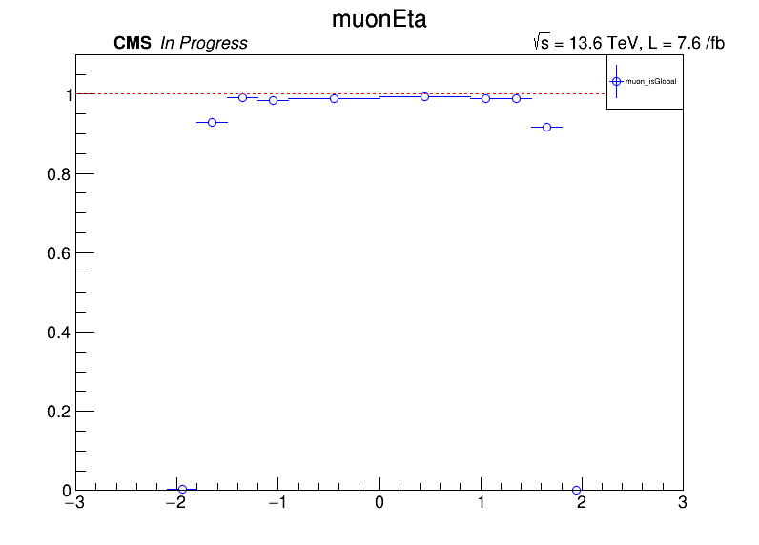
Efficiency Data vs MC

Slide 21
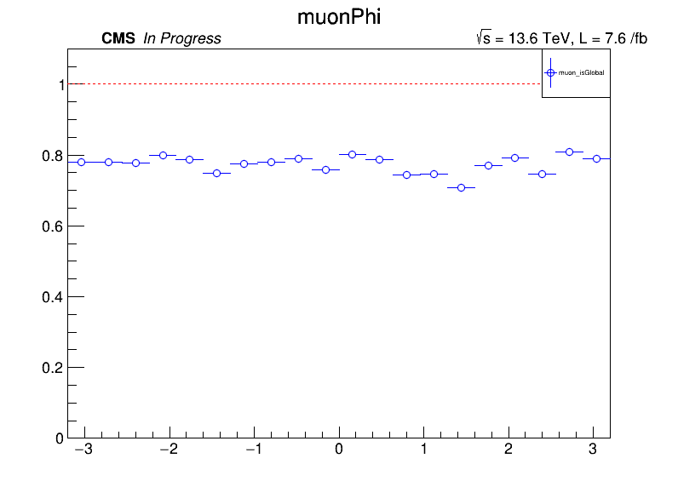
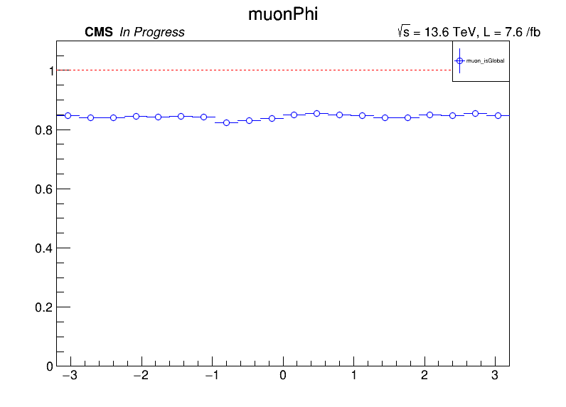
Efficiency Data vs MC

Slide 22
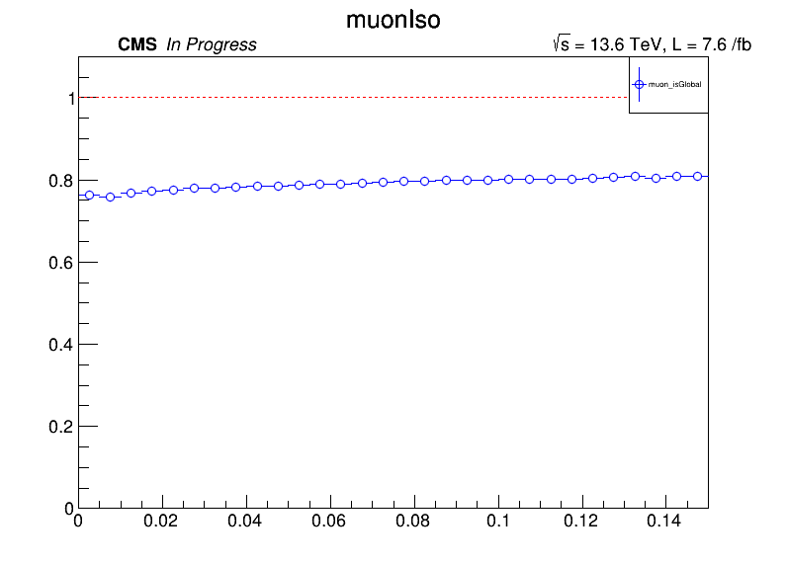
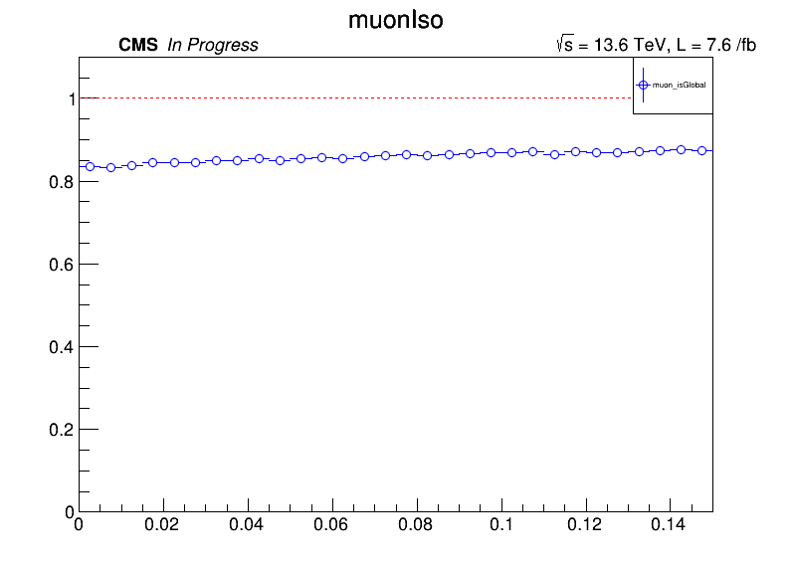
Efficiency Data vs MC
ttttreeeeeeeeeeeeeeeeeeeeeeeeeeeeeeeeeeeeee

Slide 23
Conclusion and Plan
according to mc matching (RPC muon & Global muon) gives little low matching efficiency. However, it gives better fake rate
it seems MC simulation of the RPC Muon gives overestimate
need to correct the muon pt. but I have technical problem
add dimuon mass with passing probe and failing probe histogram
adopt json file from muon pog for muon efficiency

Slide 24
Backup

Slide 25
Datasets of the Run3
DATA(2022) | Delivered by LHC($fb^{−1}$) | Recorded by CMS($fb^{−1}$) | Golden JSON($fb^{−1}$)
/Muon/Run2022C-27Jun2023-v1/AOD | 7.0067 | 6.3777 | 5.0104
/Muon/Run2022D-27Jun2023-v2/AOD | 3.8044 | 3.3773 | 2.9700
/Muon/Run2022E-27Jun2023-v1/AOD | 6.7495 | 6.2649 | 5.8070
/Muon/Run2022F-PromptReco-v1/AOD | 20.1584 | 18.6049 | 17.7819
/Muon/Run2022G-PromptReco-v1/AOD | 3.6185 | 3.2748 | 3.0828
total | 41.3375 | 37.8996 | 34.6521
$$\sqrt{s}=13.6 TeV$$
Total luminosity with Golden JSON : 120.5741 $fb^{−1}$
lumimasks
Cert_Collisions2022_355100_362760_Golden.json
Cert_Collisions2023_366442_370790_Golden.json
Cert_Collisions2024_378981_385194_Golden.json
MC Simulation
/DYto2L-2Jets_MLL-50_TuneCP5_13p6TeV_amcatnloFXFX-pythia8/Run3Summer22DRPremix-124X_mcRun3_2022_realistic_v12-v4/AODSIM
NEvents : 72909628
DATA(2023) | Delivered by LHC($fb^{−1}$) | Recorded by CMS($fb^{−1}$) | Golden JSON($fb^{−1}$)
/Muon*/Run2023B-PromptReco-v1/AOD | 1.267 | 1.134 | 0.617
/Muon*/Run2023C-PromptReco-v4/AOD | 20.064 | 18.466 | 17.794
/Muon*/Run2023D-PromptReco-v2/AOD | 10.761 | 9.897 | 9.451
total | 32.094 | 29.504 | 27.862
DATA(2024) | Delivered by LHC($fb^{−1}$) | Recorded by CMS($fb^{−1}$) | Golden JSON($fb^{−1}$)
/Muon*/Run2024B-PromptReco-v1/AOD | 0.742 | 0.656 | 0.13
/Muon*/Run2024C-PromptReco-v1/AOD | 7.95 | 7.434 | 7.238
/Muon*/Run2024D-PromptReco-v1/AOD | 8.899 | 8.301 | 7.957
/Muon*/Run2024E-PromptReco-v2/AOD | 12.899 | 11.92 | 11.319
/Muon*/Run2024F-PromptReco-v1/AOD | 30.786 | 28.433 | 25.79
/Muon*/Run2024G-PromptReco-v1/AOD | 5.988 | 5.484 | 5.477
total | 66.29 | 61.42 | 58.06

Slide 26
Muon Tight ID
global muon and PF muon.
${χ^{2}}/{ndof}$ of the global muon track fit < 10
At least one muon chamber hit included in the global-muon track fit
Muon segments in at least two muon stations. (Implies that the muon is also an arbitrated tracker muon)
Its tracker track has transverse impact parameter $d_{xy}<2 mm$ w.r.t. the primary vertex.
The longitudinal distance of the tracker track wrt. the primary vertex is d_z < 5 mm
Number of pixel hits > 0
Cut on number of tracker layers with hits >5

