Slide 1
htop Status Report
Wooyeon Kwon
wkwon@cern.ch
10 Feb, 2025

Slide 2
htop cluster configuration
*HYU-server(210.117.210.210) has independent system
htop
<master node>
compute-0-1
<cpu node>
compute-0-2
<cpu node>
compute-0-3
<cpu node>
gpu-0-1
<gpu node>
gpu-0-2
<gpu node>

Slide 3
htop master node
Role : file server, job request and scheduling, distribute the OS image to the diskless nodes.
Specs
CPU : Intel(R) Xeon(R) CPU E5-2609 v3 @ 1.90GHz (6(6) core) (×1)
RAM : 16GB DDR4 2113 (×2)
DISK
total storage volume : 116TB (29TB left)
DISK | Volume | Avail | used | use% | RAID | usage
/dev/sda | 299GB | 166GB | 97GB | 32% | RAID5 (10TB*3) | Linux OS, softwares, swap
/dev/sdb | 8.0TB | 3.0TB | 5.1TB | 64% |  | user home directory
/dev/sdc | 21TB | 12TB | 8.1TB | 38% |  | data storage (/data/)
/dev/sdd | 29TB | 14TB | 68TB | 78% | RAID6 (12TB*7) | data storage (/data1/)
/dev/sde | 58TB |  |  |  |  | data storage (/data1/)

Slide 4
CPU and GPU nodes
CPU node specs (compute-0-1,2,3)
CPU : Intel(R) Xeon(R) CPU E5-2630 v3 @ 2.40GHz (8(16) core) (×2)
RAM : 32GB
GPU node specs (gpu-0-1)
CPU : Intel(R) Xeon(R) CPU E5-2690 v4 @ 2.60GHz (14(28) core) (×2)
RAM : 128GB
GPU : NVIDIA TITAN XP (×4)
GPU node specs (gpu-0-2)
CPU : Intel(R) Xeon(R) CPU E5-2690 v4 @ 2.60GHz (14(28) core) (×2)
RAM : 128GB
GPU : NVIDIA TITAN RTX (×4)

Slide 5
Summary
Node | CPU | RAM | GPU | DISK
htop(master node) | 1.9GHz, 6(6) core | 32GB | - | 116TB
compute-0-1,2,3 | 2.4GHz, 16(32) core | 32GB | - | -
gpu-0-1 | 2.6GHz, 28(56) core | 128GB | NVIDIA TITAN XP | -
gpu-0-2 | 2.6GHz, 28(56) core | 128GB | NVIDIA TITAN RTX | -
DISK | Volume | Avail | used | use% | RAID
/dev/sda | 299GB | 166GB | 97GB | 32% | RAID5 (10TB*3)
/dev/sdb | 8.0TB | 3.0TB | 5.1TB | 64%
/dev/sdc | 21TB | 12TB | 8.1TB | 38%
/dev/sdd | 29TB | 14TB | 68TB | 78% | RAID6 (12TB*7)
/dev/sde | 58TB
total actual available storage : 116TB (29TB left)

Slide 6
htop cluster OS migration

Slide 7
Motivation
Security updates and patches will be discontinued
CentOS 7 will reach official end of support on June 30, 2024. Security updates and patches will not be available after this date, leaving our system at high risk for security vulnerabilities. deadline has already passed.
End of technical support
There will be no official technical support for CentOS 7 after support ends, which means it can be difficult to find a solution when you run into problems.

Slide 8
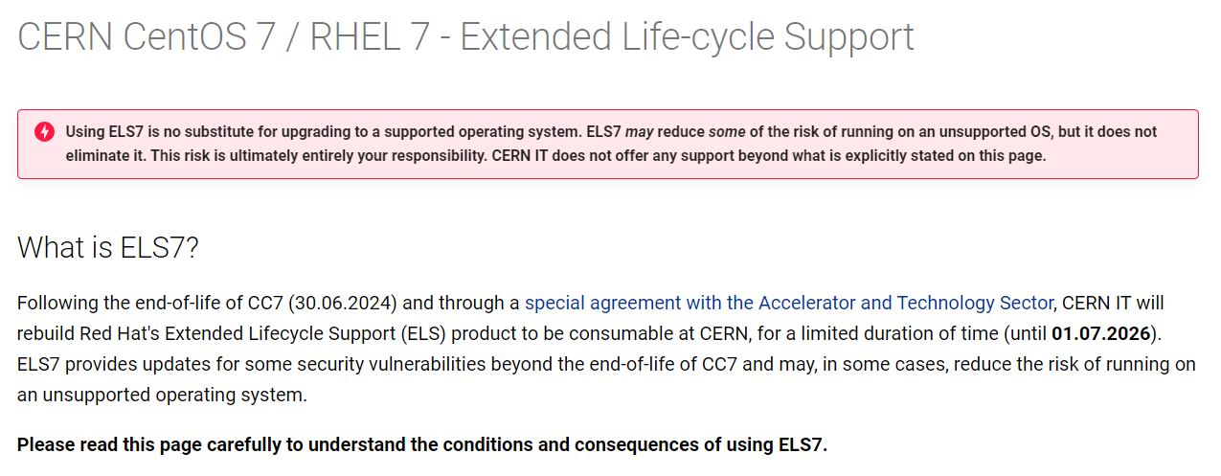
Motivation
End of technical support
EPEL and most of package repos have already ended.
CERN CentOS7 give extra support until 1.7.2026. (Maybe it will be real deadline). However, They highly recommend OS migration.

Slide 9
Motivation
Compatibility issues
Over time, we may experience compatibility issues with new software. Newer software will likely no longer support CentOS 7.
CERN software for CC7 (eg: locmap, cern-get-keytab, eos, afs, etc) will not supported after 30.06.2024
CMSSW works well now. However, there is no guarantee that CMSSW will continue to support el7. (lxplus doesn’t support el7 directly and they build CMSSW of el7 with el8 environment)

Slide 10
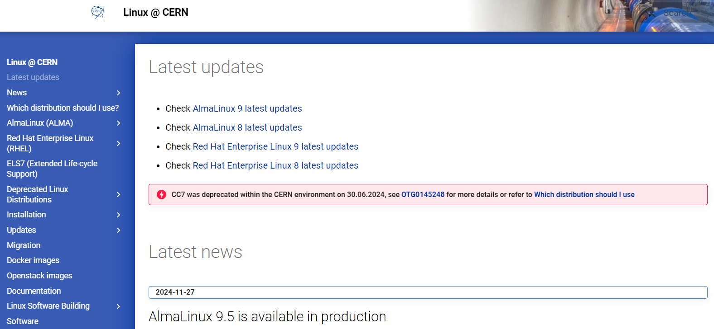
New OS to migration
ALMA(AlmaLinux) 9.5
officially used in CERN
folk version of RHEL9.5(lxplus OS)
CentOS latest version become a sort of alpha test version of RHEL ☹. So, I suggest to use ALMA

Slide 11
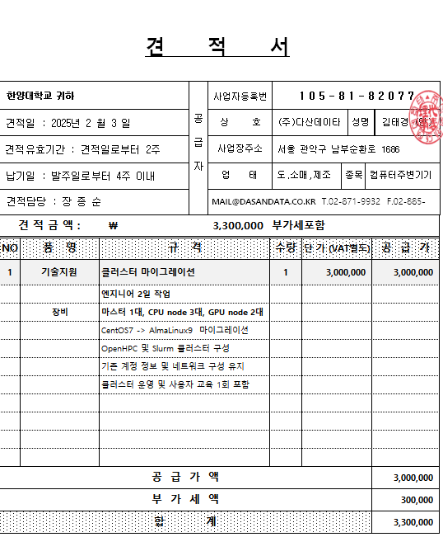
Reply from Dasan center
if we got the service from Dasan, we need to pay
3,300,000 KRW…

Slide 12
Backup

Slide 13
Intel(R) Xeon(R) CPU E5-2609 v3 @ 1.90GHz
htop master node CPU
Socket: LGA2011-v3
Clockspeed: 1.9 GHz
Cores: 6 Threads: 6
L1 Instruction Cache: 6 x 32 KB
L1 Data Cache: 6 x 32 KB
L2 Cache: 6 x 256 KB
L3 Cache : 15 MB
average mark rating : 4430 (multi) / 1097 (single)

Slide 14
Intel(R) Xeon(R) CPU E5-2630 v3 @ 2.40GHz
compute node CPU
Socket: LGA2011-v3
Clockspeed: 2.4 GHz / Turbo speed 3.2GHz
Cores: 8 Threads: 16
L1 Instruction Cache: 8 x 32 KB
L1 Data Cache: 8 x 32 KB
L2 Cache: 8 x 256 KB
L3 Cache: 160 MB
average mark rating : 10367 (multi) / 1763 (single)

Slide 15
Intel(R) Xeon(R) CPU E5-2690 v4 @ 2.60GHz
gpu node CPU
Socket: FCLGA2011-3
Clockspeed: 2.6 GHz / Turbo speed 3.5GHz
Cores: 14 Threads: 28
L1 Instruction Cache: 14 x 32 KB
L1 Data Cache: 14 x 32 KB
L2 Cache: 14 x 256 KB
L3 Cache: 35 MB
average mark rating : 19482 (multi) / 2076 (single)
*Mark rating of brand-new high end cpu(AMD Ryzen Threadripper PRO 7995WX) :
153598 (multi)/ 3964(single)

Slide 16
NVIDIA TITAN XP / NVIDIA TITAN RTX
NVIDIA TITAN XP(gpu-0-1 node gpu)
Clock speed: 1405 MHz / boost speed 1582MHz
Max Memory Size: 12GB
Memory clock : 1426
average mark rating : 18707
NVIDIA TITAN RTX(gpu-0-2 node gpu)
Clock speed: 1350 MHz / boost speed 1770MHz
Max Memory Size: 24GB
Memory clock : 1750
average mark rating : 19946
*Mark rating of brand-new high end gpu(RTX 4090) : 38578

